Slide 1


Data Management, Transactional and Deployment Patterns

Slide 2
Database Patterns for Data Management
Database design patterns play a pivotal role in shaping the microservices database architecture.
These patterns provide the framework for whether each service should have its own dedicated database or share a common one.
Microservices architecture breaks an application into loosely coupled services, which can be independently developed and deployed.

Slide 3
Database Patterns for Data Management
Let's explore some of the key database patterns:
Database per service
Shared Database per service
Command Query Responsibility Segregation
Event Sourcing
Saga Pattern
Choreography
Orchestration

Slide 4
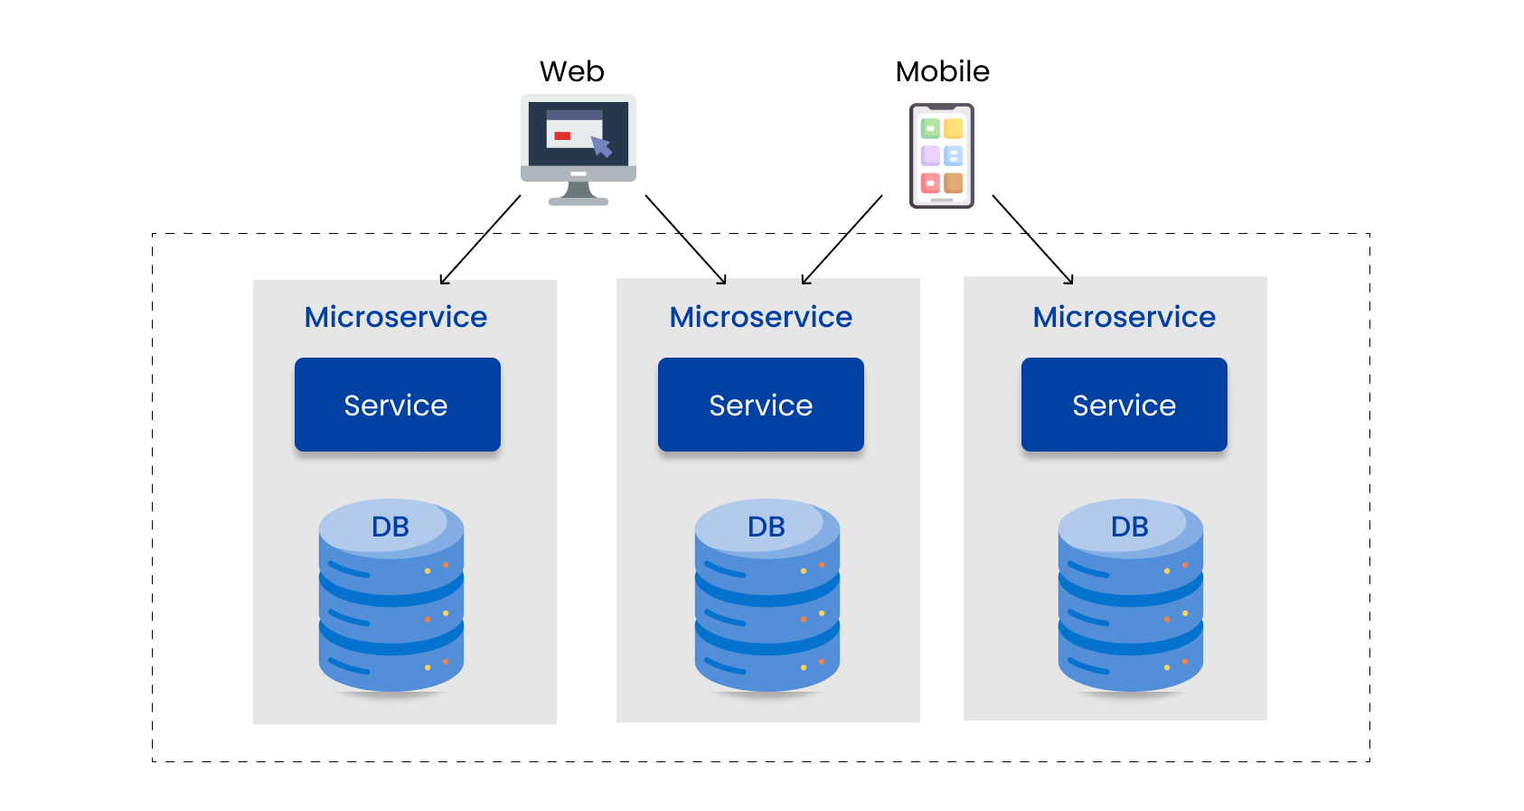
1. Database per service
In this pattern, each microservice manages its own database. Communication between the databases of different microservices occurs via well-defined APIs.
The database per service pattern promotes scalability, loose coupling between databases, and simplified impact analysis.

Slide 5
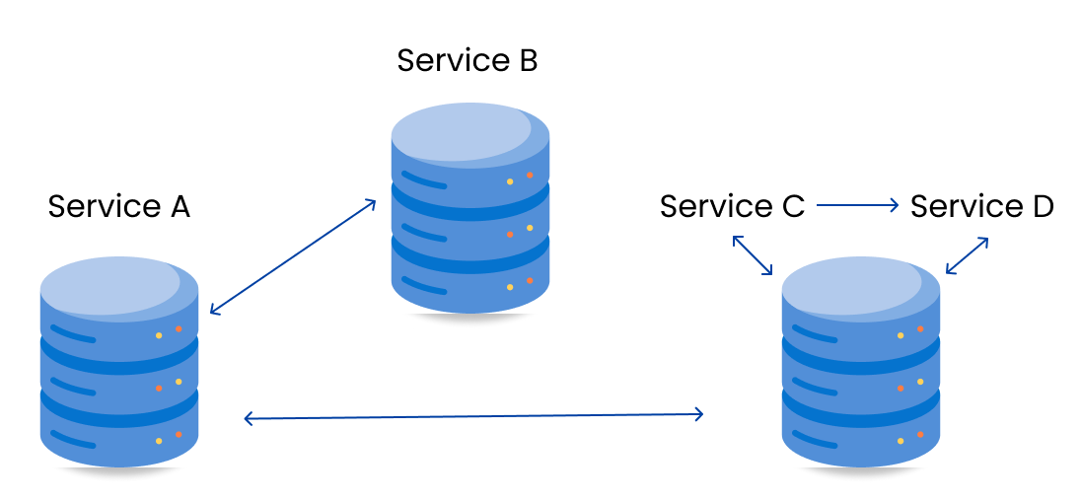
2. Shared Database per service
Here, microservices share a common database, with each service accessing it using local ACID transactions.
However, sharing a database can counteract some of the core benefits of microservices such as loose coupling and service independence.
A single point of failure can crash the entire system if the shared database fails.

Slide 6
3. Command Query Responsibility Segregation (CQRS)
The implementation of database-per-service necessitates querying that involves retrieving data from multiple services. This requires the combination of data from different services.
The CQRS pattern suggests splitting the application into two components: the command side and the query side.
The command side processes Create, Update, and Delete requests.
The query side utilizes materialized views to handle the query component.

Slide 7
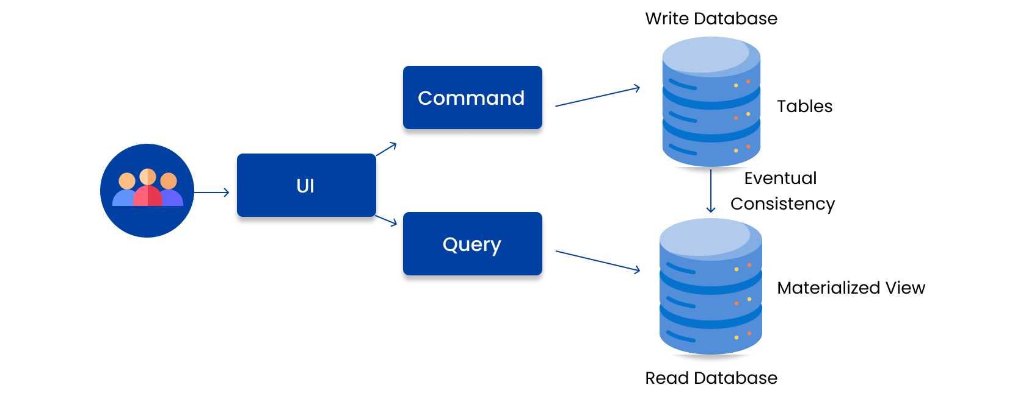
3. Command Query Responsibility Segregation (CQRS)
he utilization of the event sourcing pattern is common practice in conjunction with it, in order to generate events for every alteration in data.
Materialized views are maintained in a current state by subscribing to a continuous stream of events.

Slide 8
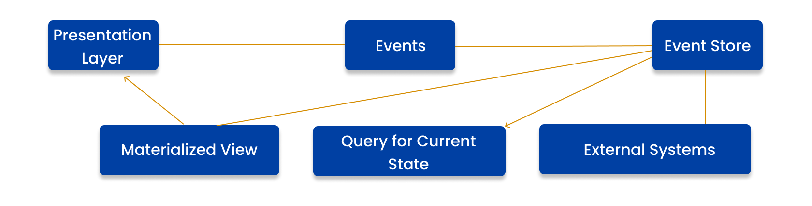
4. Event Sourcing
This pattern stores the aggregate data as a series of state-altering events. Any changes or additions to the data generate a new event.
These events can be stored in a list and replayed at a later time, thereby allowing services to subscribe to and retrieve events via APIs.

Slide 9
5. Saga Pattern
To maintain data consistency across services, it is crucial to address the challenge of having separate databases for each service while dealing with business transactions that involve multiple services.
Compensating requests are triggered by failed requests.
There are two possible implementation methods:
Choreography
Orchestration

Slide 10
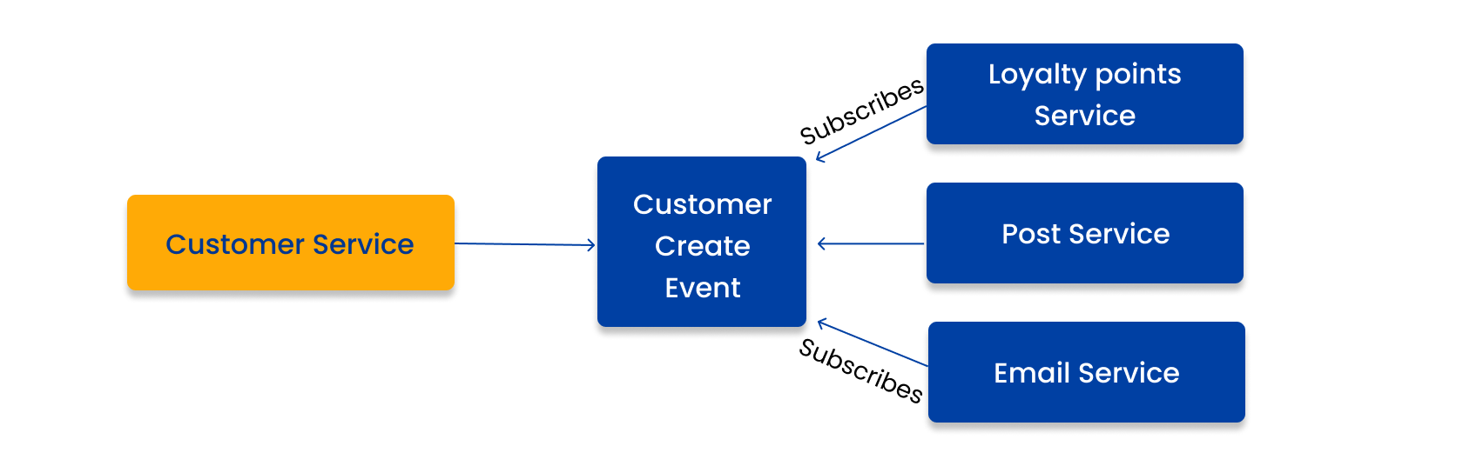
5. Saga Pattern (Choreography)
Without central coordination, each service produces and monitors events from other services and decides whether any action is needed. Choreography facilitates information and value sharing.

Slide 11
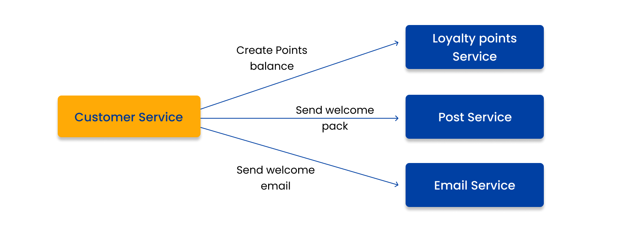
5. Saga Pattern (Orchestration)
An orchestrator sequences the business logic and makes decisions in a saga. Orchestration is used when all participants in a process are under a single control domain, such as within a single organization.

Slide 12
Transactional Patterns
Distributed transactions are complex and costly because they involve coordinating multiple services, networks, and databases, which can introduce latency, failures, and inconsistencies.
Traditional approaches, such as using a two-phase commit protocol or a distributed lock manager, are not suitable for microservices, as they create tight coupling, reduce availability, and increase the risk of deadlock and data corruption.
Therefore, you need to adopt a different mindset and strategy for dealing with distributed transactions in microservices.

Slide 13
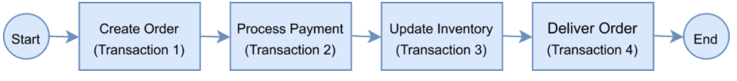
Transactional Patterns
To demonstrate the use of distributed transactions, we’ll take an example of an e-commerce application that processes online orders and is implemented with microservice architecture.
There is a microservice to create the orders, one that processes the payment, another that updates the inventory and the last one that delivers the order.
Each of these microservices performs a local transaction to implement the individual functionalities
To ensure a successful order processing service, all four microservices must complete the individual local transactions. If any of the microservices fail to complete its local transaction, all the completed preceding transactions should roll back to ensure data integrity.

Slide 14
Understanding Two-Phase Commit Protocol
The Two-Phase Commit protocol (2PC) is a widely used pattern to implement distributed transactions. It is to use this pattern in a microservice architecture to implement distributed transactions.
In a two-phase commit protocol, there is a coordinator component that is responsible for controlling the transaction and contains the logic to manage the transaction.
As the name indicates, the two-phase commit protocol runs a distributed transaction in two phases:
Prepare Phase – The coordinator asks the participating nodes whether they are ready to commit the transaction. The participants returned with a yes or no.
Commit Phase – If all the participating nodes respond affirmatively in phase 1, the coordinator asks all of them to commit. If at least one node returns negative, the coordinator asks all participants to roll back their local transactions.

Slide 15
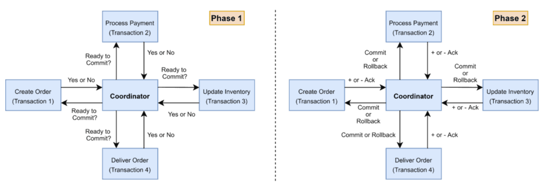
Understanding Two-Phase Commit Protocol

Slide 16
Problems in 2Pc Protocol
Although 2PC is useful to implement a distributed transaction, it has the following shortcomings:
The onus of the transaction is on the coordinator node, and it can become the single point of failure.
All other services need to wait until the slowest service finishes its confirmation. So, the overall performance of the transaction is bound by the slowest service.
The two-phase commit protocol is slow by design due to the chattiness and dependency on the coordinator. So, it can lead to scalability and performance issues in a microservice-based architecture involving multiple services.
Two-phase commit protocol is not supported in NoSQL databases. Therefore, in a microservice architecture where one or more services use NoSQL databases, we can’t apply a two-phase commit.

Slide 17
Transactional Outbox Pattern
A common challenge that arises when handling distributed transactions in microservices is how to reliably publish events to other services without losing or duplicating them.
One design pattern that can address this challenge is the outbox pattern.
The outbox pattern is based on the idea of using a database table as a temporary buffer for storing events that need to be published, and using a separate process to read and send them to a message broker.
This way, you can ensure that the events are published atomically with the local transactions, and avoid inconsistencies and failures due to network issues or broker outages, but you also need to deal with the potential for duplicate or out-of-order events.

Slide 18
SAGA Pattern
The saga pattern is based on the idea of breaking a long-running transaction into a series of local transactions, each executed by a different service, and compensating for any failures along the way.
A saga can be orchestrated by a central service that controls the workflow and triggers the compensation logic, or choreographed by each service that publishes and subscribes to events.
The saga pattern allows you to achieve eventual consistency and avoid blocking and locking resources, but it also requires careful design and testing of the compensation logic and the event handling.

Slide 19
SAGA Pattern
The Saga architecture pattern provides transaction management using a sequence of local transactions.
A local transaction is the unit of work performed by a Saga participant. Every operation that is part of the Saga can be rolled back by a compensating transaction.
Further, the Saga pattern guarantees that either all operations complete successfully or the corresponding compensation transactions are run to undo the work previously completed.

Slide 20
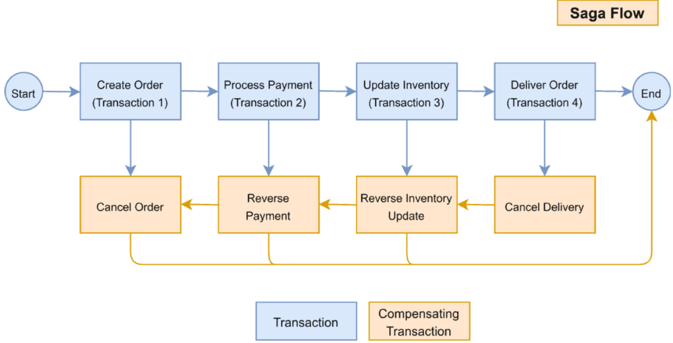
SAGA Pattern
The Saga Execution Coordinator (SEC) guarantees these principles:

Slide 21
SAGA Pattern
The Saga Execution Coordinator is the central component to implement a Saga flow. It contains a Saga log that captures the sequence of events of a distributed transaction.
For any failure, the SEC component inspects the Saga log to identify the impacted components and the sequence in which the compensating transactions should run.
For any failure in the SEC component, it can read the Saga log once it’s coming back up.

Slide 22
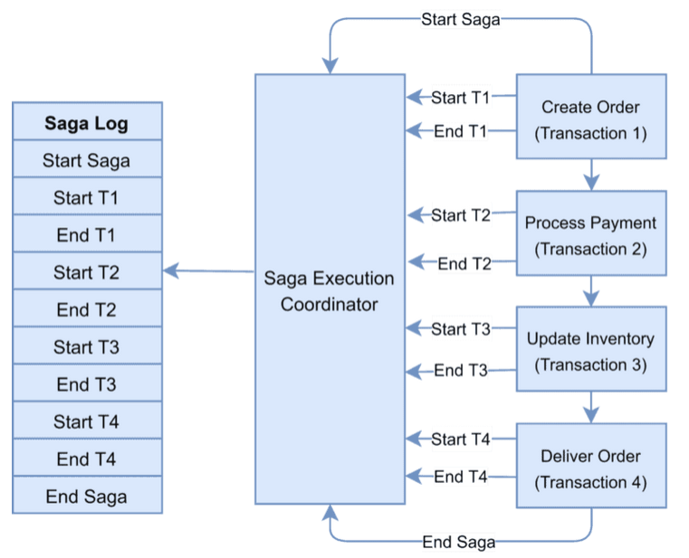
SAGA Pattern

Slide 23
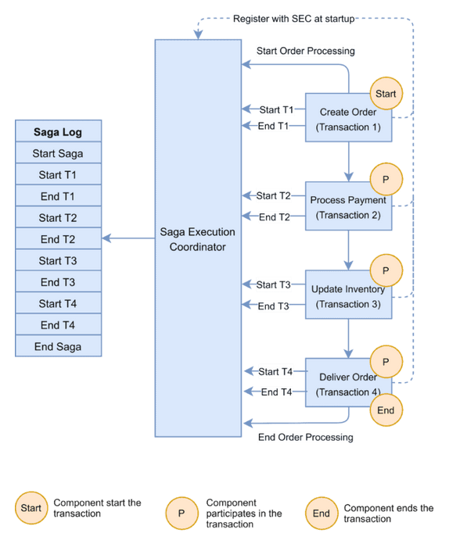
SAGA Pattern

Slide 24
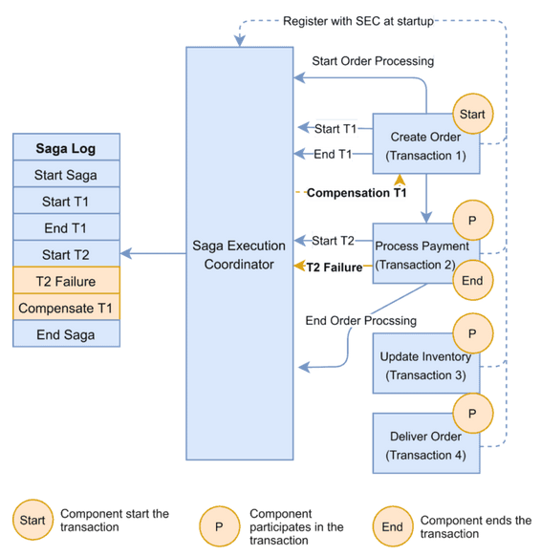
SAGA Pattern

Slide 25
Deployment Pattern
The microservices deployment pattern is a technique for updating and modifying software components.
A microservices deployment pattern or strategy enables easy deployments and allows you to modify microservices.
Microservices are the most scalable way of developing software. But that means nothing unless we choose the right way to deploy microservices: processes or containers? Run on my servers or use the cloud? Do I need Kubernetes? When it comes to the microservice architecture, there is such an abundance of options and it is hard to know which is best.

Slide 26
The 5 ways to deploy microservices
Microservice applications can run in many ways, each with different tradeoffs and cost structures. What works for small applications spanning a few services will likely not suffice for large-scale systems.
From simple to complex, here are the five ways of running microservices:
Single machine, multiple processes: buy or rent a server and run the microservices as processes.
Multiple machines, multiple processes: the obvious next step is adding more servers and distributing the load, offering more scalability and availability.
Containers: packaging the microservices inside a container makes it easier to deploy and run along with other services. It’s also the first step towards Kubernetes.
Orchestrator: orchestrators such as Kubernetes or Nomad are complete platforms designed to run thousands of containers simultaneously.
Serverless: serverless allows us to forget about processes, containers, and servers, and run code directly in the cloud.

Slide 27
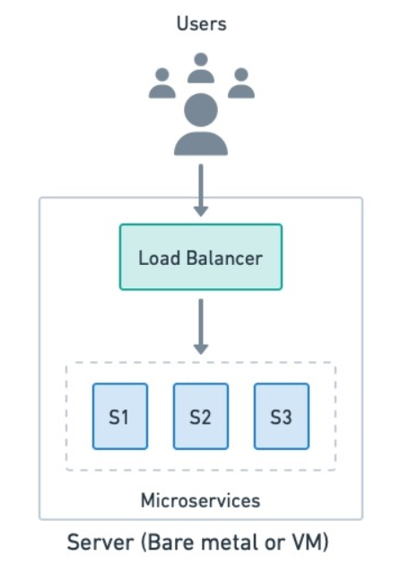
Option 1: Single machine, multiple processes
At the most basic level, we can run a microservice application as multiple processes on a single machine. Each service listens to a different port and communicates over a loopback interface.

Slide 28
Option 1: Single machine, multiple processes
The benefits of this approach are:
Lightweight: there is no overhead as it’s just processes running on a server.
Convenience: it’s a great way to experience microservices without the learning curve that other tools have.
Easy troubleshooting: everything is in the same place, so finding a problem or reverting to a working configuration in case of trouble is very straightforward, if you have continuous delivery in place.
Fixed billing: we know how much we’ll have to pay each month.

Slide 29
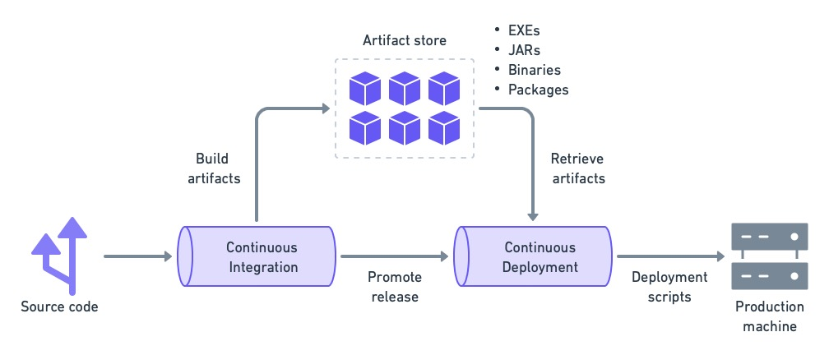
Option 1: Single machine, multiple processes

Slide 30
Option 2: Multiple machines and processes
This option is essentially an upgrade of option 1. When the application exceeds the capacity of a server, we can scale up (upgrade the server) or scale sideways (add more servers).
In the case of microservices, horizontally scaling into two or more machines makes more sense since we get improved availability as a bonus. And, once we have a distributed setup, we can always scale up by upgrading servers.

Slide 31
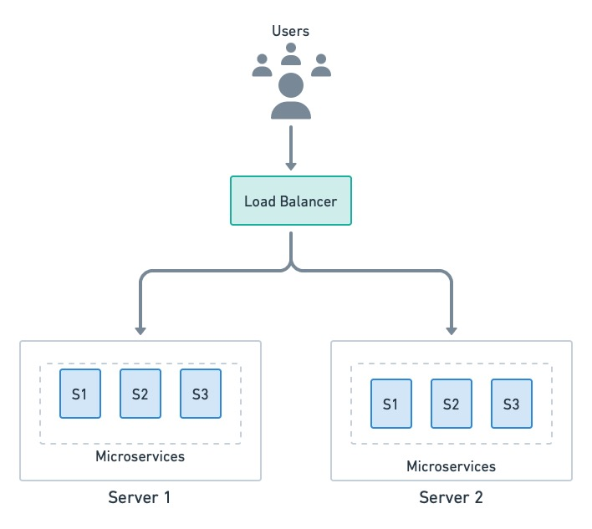
Option 2: Multiple machines and processes

Slide 32
Option 3: Deploy microservices with containers
While running microservices directly as processes is very efficient, it comes at a cost.
The server must be meticulously maintained with the necessary dependencies and tools.
A runaway process can consume all the memory or CPU.
Deploying and monitoring the microservices is a brittle process.
All these shortcomings can be mitigated with containers. Containers are packages that contain everything a program needs to run.
A container image is a self-contained unit that can run on any server without having to install any dependencies or tools first (other than the container runtime itself).

Slide 33
Option 3: Deploy microservices with containers
The benefits of this approach:
Isolation: contained processes are isolated from one another and the OS. Each container has a private filesystem, so dependency conflicts are impossible (as long as you are not abusing volumes).
Concurrency: we can run multiple instances of the same container image without conflicts.
Less overhead: since there is no need to boot an entire OS, containers are much more lightweight than VMs.
No-install deployments: installing a container is just a matter of downloading and running the image. There is no installation step required.
Resource control: we can put CPU and memory limits on containers so they don’t destabilize the server.

Slide 34
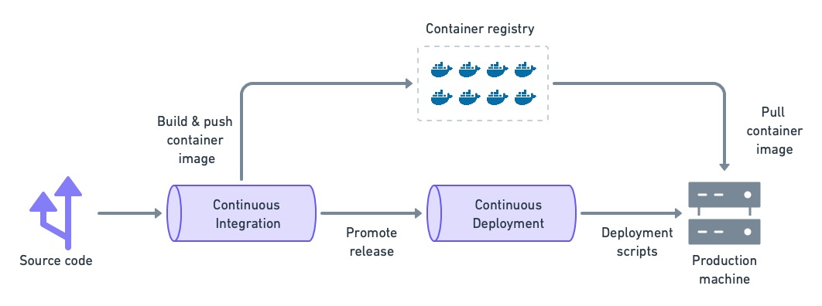
Option 3: Deploy microservices with containers

Slide 35
Option 4: Orchestrators
Orchestrators are platforms specialized in distributing container workloads over a group of servers.
The most well-known orchestrator is Kubernetes, a Google-created open-source project maintained by the Cloud Native Computing Foundation.
Orchestrators provide, in addition to container management, extensive network features like routing, security, load balancing, and centralized logs — everything you may need to run a microservice application.

Slide 36
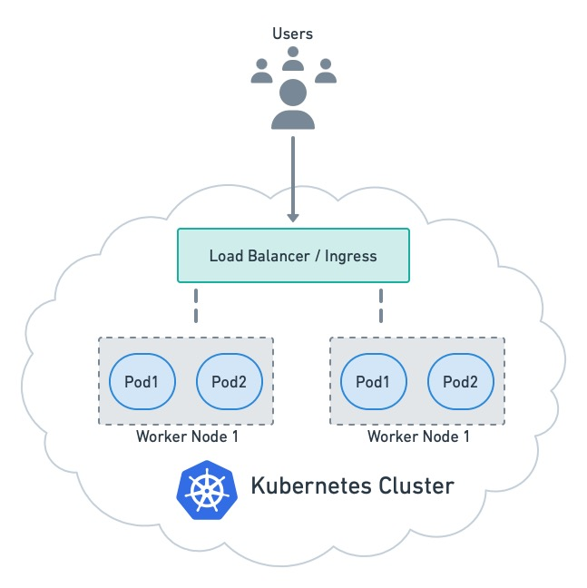
Option 4: Orchestrators

Slide 37
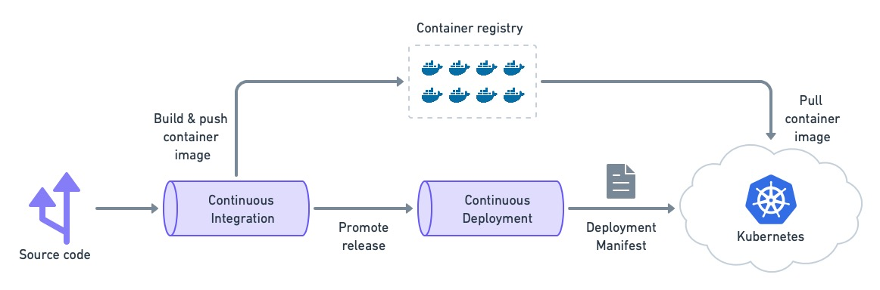
Option 4: Orchestrators
Kubernetes is supported by all cloud providers and is the de facto platform for microservice deployment. As such, you might think this is the absolute best way to run microservices.

Slide 38
Option 5: Deploy microservices as serverless functions
Serverless functions deviate from everything else we’ve discussed so far. Instead of servers, processes, or containers, we use the cloud to simply run code on demand.
Serverless offerings like AWS Lambda and Google Cloud Functions handle all the infrastructure details required for scalable and highly-available services, leaving us free to focus on coding.​

Slide 39
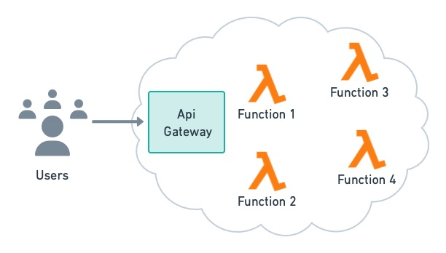
Option 5: Deploy microservices as serverless functions

Slide 40
Deployment Patterns
If the application is mature and spans many services, you will require something more robust such as managed containers or serverless, and perhaps Kubernetes later on as your application grows.
Nothing prevents you from mixing and matching different options. In fact, most companies use a mix of bare-metal servers, VMs, and Kubernetes.
A combination of solutions like running the core services on Kubernetes, a few legacy services in a VM, and reserving serverless for a few strategic functions could be the best way of taking advantage of the cloud at every turn.

Slide 41
Deployment Patterns
The microservices deployment pattern is a technique for updating and modifying software components. A microservices deployment pattern or strategy enables easy deployments and allows you to modify microservices.
The following subsections list the microservice deployment patterns that help improve microservice availability:
Canary Deployment
Blue/Green Deployment
Dark Launching
A/B Testing

Slide 42
1. Canary Deployment
A “canary deployment” is a method of spotting possible issues before they affect all consumers.
Before making a new feature available to everyone, the plan is to only show it to a select group of users.
In a canary release, we keep an eye on what transpires after the feature is made available. If there are issues with the release, we fix them.
We transfer the canary release to the actual production environment once its stability has been established.
Notes:
Pros:
allow us to test in production with real users and use cases and compare different service versions side by side.
It’s cheaper than a blue-green deployment because it does not require two production environments.
And finally, it is fast and safe to trigger a rollback to a previous version of an application.
Cons:
Drawbacks to canary deployments involve testing in production and the implementations needed.
Scripting a canary release can be complex: manual verification or testing can take time,
The required monitoring and instrumentation for testing in production may involve additional research.

Slide 43
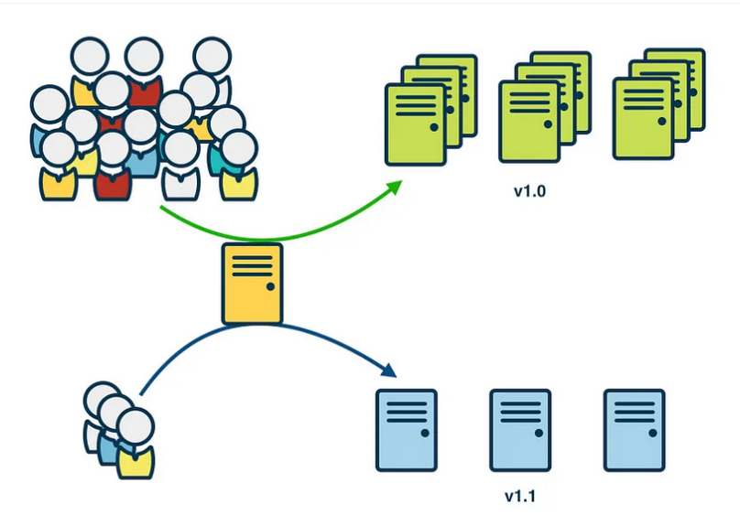
1. Canary Deployment

Slide 44
2. Blue/Green Deployment
Blue/green is a technique for deployments where the existing running deployment is left in place. A new version of the application is installed in parallel with the existing version.
When the new version is ready, cut over to the new version by changing the load balancer configuration.
This makes rollback really simple and gives time to make sure that the new version works as expected before putting it live.
Notes:
Pros:
No downtime
It is simple, fast, well-understood, and easy to implement.
Rollback is also straightforward, because you can simply flip traffic back to the old environment in case of any issues.
not as risky compared to other deployment strategies.
Cons:
Cost is a drawback to blue-green deployments. Replicating a production environment can be complex and expensive, especially when working with microservices.
Quality assurance and user acceptance testing may not identify all of the anomalies or regressions either, and so shifting all user traffic at once can present risks.
An outage or issue could also have a wide-scale business impact before a rollback is triggered, and depending on the implementation, in-flight user transactions may be lost when the shift in traffic is made.

Slide 45
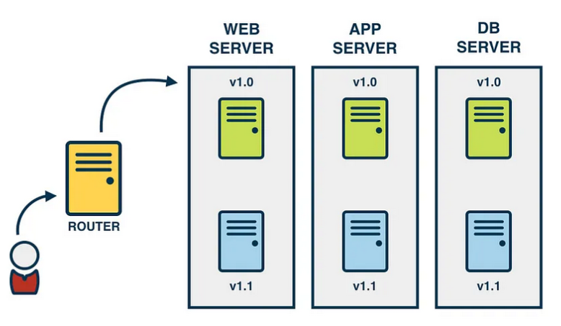
2. Blue/Green Deployment

Slide 46
3. Dark Launching
A dark launch is a technique that deploys updates to microservices catering to a small percentage of the user base.
It does not affect the entire system. When you dark launch a new feature, you’ll initially hide it from most end users.
For example, a new feature is being added to a social media platform. Instead of announcing the feature to all users, the developers may do a dark launch, where the feature is made available to a small group of users without any notification. This allows the developers to gather feedback and test the effectiveness of the feature without any potential bias from users knowing that they are participating in a test.
Notes:
Pros:
Perform more tests before releasing your product. This lets you catch bugs early, thus saving time and cost associated with fixing bugs in production.
Allows your development team to test the new system architecture before end-users can see it.
Rollback is also straightforward, because you can simply flip traffic back to the old environment in case of any issues.
Not as risky compared to other deployment strategies.
Cons:
Microservices are behind feature toggles, which can lead to increased costs and time for debugging microservices.
Additionally, to enable continuous development, teams must be able to move microservices behind feature toggles during development itself.

Slide 47
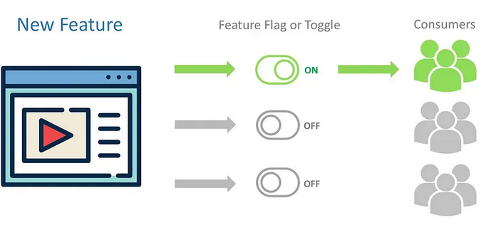
3. Dark Launching
Feature toggles — also known as feature flags — allow you to further decouple the deployment of different software versions from the release of features to users. You can deploy new versions of an application as often as needed, with certain features disabled: releasing a feature to users is simply a matter of toggling it “on.”

Slide 48
4. A/B Testing
Two versions of an app are compared using A/B testing to see which one performs better.
An experiment is like A/B testing. In A/B testing, we present users with two or more page versions at random.
Then, we use statistical analysis to determine which variant is more effective in achieving our objectives.
Notes:
Pros:
Get clear evidence It’s easy to see how many users complete a transaction with site A over site B. The evidence is based on real behaviour, so is hard data of the type that money men love (and can be presented in a simple-looking, hard hitting chart).
Test new ideas If you have an innovative idea for an existing site, A/B testing provides hard proof as to whether it works or not. However, you will need to implement that big idea in hard code before you can test it this way.
Optimise one step at a time If you run a large site, or many sites, then A/B testing is a fantastic opportunity to “patch” test, by starting out in a small corner and then working up to the main pages of the site. However, can smaller site users with less traffic afford to gamble with real users by giving half of them a site experience that might not be optimal?
Answer specific design questions Are green buttons better than red ones for your site design? This and many other questions can be answered by A/B testing as they allow the designer to test different colours, placement of buttons, page layouts, different images which are all good areas to slowly improve a website.
Cons:
Can take lots of time and resources A/B testing can take a lot longer to set up than other forms of testing. Setting up the A/B system can be a resource and time hog, although third-party services can help. Depending on the company size, there may be endless meetings about which variables to include in the tests. Once a set of variables have been agreed, designers and coders will need to effectively work on double the amount of information. In addition, in order to get conclusive results, tests can take weeks and months for low-traffic sites.
Only works for specific goals This kind of testing is ideal if you want to solve one dilemma, which product page gives me the best results? But, if your goals are less easy to measure pure A/B testing won’t provide those answers.
Doesn’t improve a dud If your site had usability problems to begin with and the variations are just an iteration of that, it is likely to still have the fundamental flaws that your other site contained. A/B Testing won’t reveal these types of flaw or reveal user frustration and you won’t be able pick up on the reasons behind the site’s problems. Just because A resulted in more sales, it is only in relation to B. Removing the original usability issue could be much quicker to identify and result in much better results.
Could end up with constant testing Once the test is over, that is it. The data is useless for anything else. Further A/B tests will have to start from a new baseline and other types of testing will only likely be applied to the more successful site, when they could have found equally useful information from the rejected version.

Slide 49
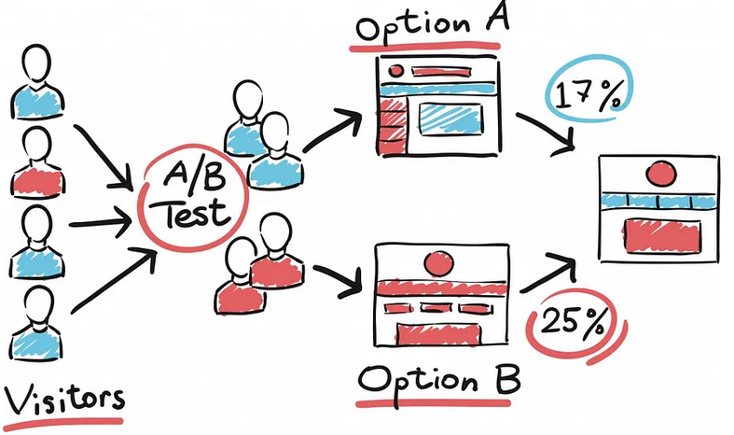
4. A/B Testing

